Slide 1


OBJECT-ORIENTED ANALYSIS AND DESIGN WITH UML 2.0
Bé m«n C«ng nghÖ phÇn mÒm
KHOA CÔNG NGHỆ THÔNG TIN
TRƯỜNG ĐẠI HỌC BÁCH KHOA HÀ NỘI
Bài 7. Thiết kế use case
Nguyễn Thị Thu Trang
trangntt-fit@mail.hut.edu.vn
Notes:
Mastering OOAD w/ UML 2.0 – Instructor Notes
Module 11 - Use-Case Design

Slide 2
Mục đích
Kiểm tra sự nhất quán trong quá trình thực hiện use case
Tinh chỉnh sự hiện thực hóa use case từ mô hình phân tích sử dụng các thành phần thiết kế
Notes:
Mastering OOAD w/ UML 2.0 – Instructor Notes
Module 11 - Use-Case Design
Use-Case Design is when the use-case implementations are verified for consistency. This means that for all the use-case realizations for each use case, the following items are verified:
All the necessary behavior to support a use-case implementation has been distributed among the appropriate participating classes.
The use case flows naturally over the participating design elements.
All associations between design elements (classes or subsystems) needed for the use-case realizations have been defined.
All of the attributes needed for the use-cases have been defined.
To assist in this verification, use-case realizations initially developed in Use-Case Analysis are refined to include the defined Design model elements from the originally defined Analysis Model elements. The Design Model elements are the design classes and subsystems that the analysis classes “morphed into.”
In addition, any applicable architectural mechanisms should be incorporated into the use-case realizations.
Use-Case Design is a cross-checking, consistency-imposing activity, focused on the “use-case thread” to make sure everything still fits together. Part of this activity involves continually reviewing the interaction diagrams, looking for inconsistencies, missing information, opportunities for re-use, and so forth.
We want to check that we have operations for the whole path of the flow of events. It is not easy to find holes (places where someone has forgotten to create operations just by looking at the Design Model).

Slide 3
Tổng quan về thiết kế use case
Design Subsystems and Interfaces
Supplementary
Specifications
Use-Case
Design
Analysis Model
Use case
Design Model
Notes:
Mastering OOAD w/ UML 2.0 – Instructor Notes
Module 11 - Use-Case Design
Use-Case Design is performed by the designer, once per use case.
Purpose:
To refine use-case realizations in terms of interactions.
To refine requirements on the operations of design classes.
To refine requirements on the operations of design subsystems and/or their interfaces.
Input Artifacts:
Analysis Model
Supplementary Specifications
Use cases
Analysis use-case realization
Design classes
Design subsystems
Design Model
Design use-case realization
Interfaces
Resulting Artifacts:
Design use-case realization
Design Model
It is important to note that there are different designers (or design teams) on a project, each with a different focus. Use-case designers are concerned with the design of the use-case realizations for a particular use case, coordinating with the necessary architects, subsystem designers, and class designers.
The use-case designer concentrates on the interactions between subsystems and “free” classes (those not contained in a subsystem) classes. He or she can defer responsibility for what happens inside the subsystems to the subsystem designer(s). That’s the beauty of encapsulation
Be careful with the discussion of project team organization, because you don’t want the discussion to turn into a discussion of OO project management concerns. Refer the students to the Essentials of Rational XDE course (DEV390) for more details on team development.

Slide 4
Tinh chỉnh việc hiện thực hóa use case
Xác định các đối tượng tham gia vào luồng use case sử dụng các thành phần thiết kế
Mô hình hóa thông điệp giữa các đối tượng vào biểu đồ tương tác
Tinh chỉnh biểu đồ lớp
Sequence Diagrams
Class Diagrams
Notes:
Mastering OOAD w/ UML 2.0 – Instructor Notes
Module 11 - Use-Case Design
You are essentially taking the use-case realization diagrams developed in Use-Case Analysis and redrawing them, using the design elements that the analysis classes were refined into, making sure that the responsibility allocation is still accurate.
Communication or sequence diagrams may be used to model these interactions. RUP recommends that sequence diagrams be used during design.
In the early stages of design, some operations might not be defined, so you might have to leave this information out and give the message a temporary name; such messages are said to be "unassigned." Later, when you have found the participating objects' operations, you should update the interaction diagram by ”mapping" the messages to these operations.
Each use-case realization should be refined to describe the interactions between participating design objects as follows:
Identify each object that participates in the use-case flow of events. These objects can be instances of design classes and subsystems, or they can be instances of actors that the participating objects interact with.
Represent each participating object in an interaction diagram. Subsystems can be represented by instances of the subsystem’s interface(s).
Illustrate the message-sending between objects by creating messages (arrows) between the objects. The name of a message should be the name of the operation invoked by it. For messages going to design classes, the operation is a class operation. For messages going to subsystems, the operation is an interface operation.
Describe what an object does when it receives a message. This is done by attaching a script or note to the corresponding message. When the person responsible for an object's class assigns and defines its operations, these notes or scripts will provide a basis for that work.
For each use-case realization, illustrate the class relationships that support the collaborations modeled in the interaction diagrams by creating one or more class diagrams.

Slide 5
Biểu diễn hệ thống con vào biểu đồ trình tự
Giao diện
  Biểu diễn bất kỳ phần tử nào thực thi giao diện
  Không có thông điệp nào được vẽ từ giao diện
Thành phần hệ thống con
  Biểu diễn một hệ thống con cụ thể
  Thông điệp có thể vẽ từ giao diện
Object A
Interface
Object B
Object A
Subsystem
Component
Object B
1: Message 1
X
2: Message 2
1: Message 1
2: Message 2
Invalid message
Valid message
Notes:
Mastering OOAD w/ UML 2.0 – Instructor Notes
Module 11 - Use-Case Design
You have two choices for representing the subsystems:
You can use the interfaces realized by the subsystem. This is the better choice in cases where any model element that realizes the same interface can be used in place of the interface. If you choose to show interfaces on the sequence diagram, be aware that you will want to ensure that no messages are sent from the interface to other objects. The reason for this is that interfaces completely encapsulate the internal realization of their operations. Therefore, you cannot be certain that all model elements that realize the interface will in fact actually be designed the same way. So on sequence diagrams, no messages should be shown being sent from interfaces.
You can use a subsystem component (which is discussed in the Subsystem Design Module) to represent the subsystem on sequence diagrams. This component is contained within the subsystem and is used to represent the subsystem in diagrams that do not support the direct use of packages and subsystems as behavioral elements. The subsystem component should be used in cases where a specific subsystem responds to a message. Messages can be sent from the subsystem proxy to other objects.
For this class, you will use interfaces to represent subsystems in the design.
There are two ways that the student can represent a subsystem on a sequence diagram; with an interface or a subsystem component. Use a component only if you know what subsystem will be used to realize the behavior.
The first message on the slide is invalid because it comes from an interface. The second message is valid because it comes from a subsystem component.

Slide 6
Mô tả chi tiết cho luồng sự kiện của use case
Chú thích cho biểu đồ tương tác
: Actor1
: ClassA
: ClassB
Scripts can be used to describe the details surrounding these messages.
1: Do Something
Script
2: Do Something More
Notes can include more information about a particular diagram element
Note
Notes:
Mastering OOAD w/ UML 2.0 – Instructor Notes
Module 11 - Use-Case Design
When fleshing out the details of how a use case is going to be implemented in the system, you may have discovered additional details or may have made some adjustments to the original use-case flow of events. If such changes are important to the external user or the customer, the original use case should be updated.
Note: The original use case should not be updated to include design details, that is what the Design Model is for. (The clarification of design details is also an important purpose of the expanded descriptions being developed in this step.)
In those cases where the flow of events is not fully clear from just examining the messages sent between participating objects, you might need to add additional descriptions to the interaction diagrams.
These steps are taken in cases where timing annotations, notes on conditional behavior, or clarification of operation behavior is needed to make it easier for external observers to read the diagrams.
Often, the name of the operation does not sufficiently explain why the operation is being performed. Textual notes or scripts in the margin of the diagram might be needed to clarify the interaction diagram. Textual notes and scripts might also be needed to represent control flow such as decision steps, looping, and branching. In addition, textual tags might be needed to correlate extension points in the use case with specific locations in interaction diagrams.

Slide 7
Tinh chỉnh các thông điệp thành thao tác
Các thông điệp được hiển thị trong các biểu đồ tương tác
: ClassA
: ClassB
: ClassA
: ClassB
1 : //Perform Responsibility
1 : performResponsibility (): result
Notes:
Emphasize how operations and attributes are domain dependent. As a quick in-class exercise: Pick a class, pick two different domains, pick two students, one for each domain, and have them choose relevant operations and attributes for the class.
Stress that because the process is use-case-driven, all discovered operations and attributes should support at least one use case. Thus, the attributes/operations that are discovered are affected by what functionality/domain you are modeling.
While discussing where to find operations, it is worth exploring with which object an operation belongs. You will find that the operation always goes in the supplier object. On the interaction diagram, the client is initiating a request from the supplier, so the supplier object/class has the operation. Some people, especially people used to functional decomposition, get this confused initially.
To identify operations on design classes:
Study the responsibilities of each corresponding analysis class, creating an operation for each responsibility. Use the description of the responsibility as the initial description of the operation.
Study the Use-Case Realizations in the class participations to see how the operations are used by the Use-Case Realizations. Extend the operations, one Use-Case Realization at a time, refining the operations, their descriptions, return types and parameters. Each Use-Case Realization's requirements, as regards classes, are textually described in the Flow of Events of the Use-Case Realization.
Study the use-case Special Requirements, to make sure that you do not miss implicit requirements on the operation that might be stated there.
Use-Case Realizations cannot provide enough information to identify all operations. To find the remaining operations, consider the following:
Is there a way to initialize a new instance of the class, including connecting it to instances of other classes to which it is associated?
Is there a need to test to see if two instances of the class are equivalent?
Is there a need to create a copy of a class instance?
Are any operations required on the class by mechanisms which they use? (Example: a “garbage collection” mechanism may require that an object be able to drop all of its references to all other objects in order for unused resources to be freed.)

Slide 8
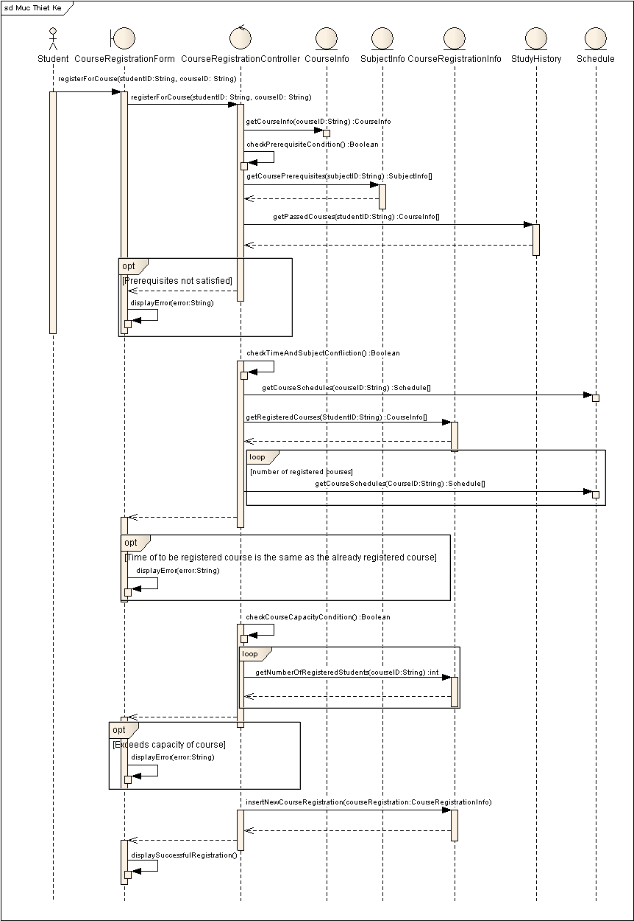
Biểu đồ trình tự mức thiết kế

Slide 9
Biểu đồ trình tự mức thiết kế (2)

Slide 10
Biểu đồ trình tự mức thiết kế (3)

Slide 11
Thống nhất mô hình thiết kế
Tên của các thành phần trong mô hình phải mô tả chức năng của chúng
Kết hợp các thành phần tương tự nhau
Sử dụng kế thừa để trừu tượng hóa các phần tử mô hình
Đảm bảo cho các thành phần mô hình và luồng sự kiện được nhất quán
Notes:
Mastering OOAD w/ UML 2.0 – Instructor Notes
Module 11 - Use-Case Design
In this step, we homogenize and blend the classes and responsibilities discovered for the different use cases. Homogenization provides a synchronization of the Use-Case Design efforts for each of the use cases before we move into the more detailed design activities.
Points to consider:
Names of model elements should describe their function. Avoid similar names and synonyms, because they make it difficult to distinguish between model elements.
Merge model elements that define similar behaviors or that represent the same phenomenon.
Merge classes that represent the same concept or have the same attributes, even if their defined behaviors are different.
Use inheritance to abstract model elements, which tends to make the model more robust.
When updating a model element, also update the affected use-case realizations.

Slide 12
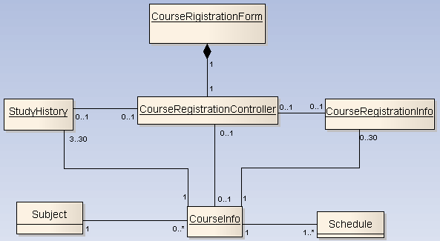
Thống nhất biểu đồ lớp

